Slide 1
Data Aggregation, Big Data analysis & visualization
Aman Bhayana | Pratik Agarwal

Slide 2
Topic - Sports
Baseball
Basketball
Cricket
Football
Hockey

Slide 3
Data Aggregation
Twitter – 120,000 tweets collected
New York Times – 770 URLs scraped
Common Crawl – 1593 URLs scraped

Slide 4
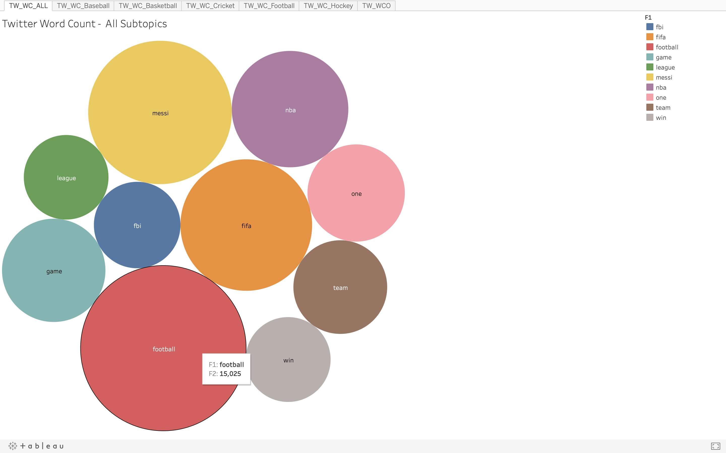
Word Count
Count the frequency of each word from the data source and display the top 10 occurring words.

Slide 5
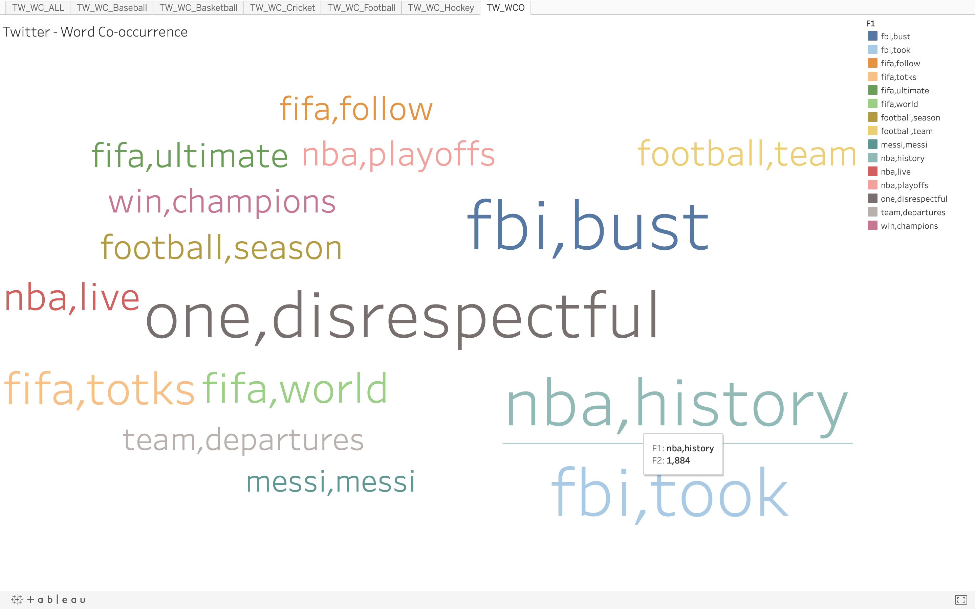
Word Co-occurrence
Count the frequency of co-occurrence of the top 10 words against the entire data set.

Slide 6
Data Visualization

